Slide 1


Slide 2

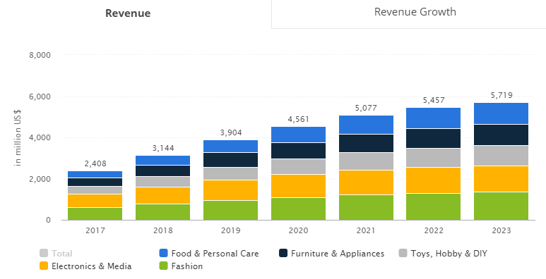
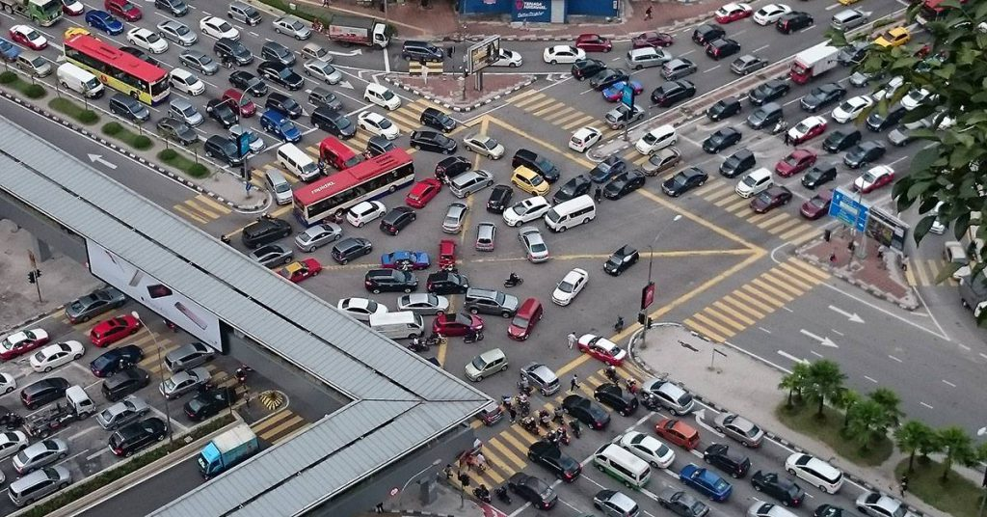

Slide 3
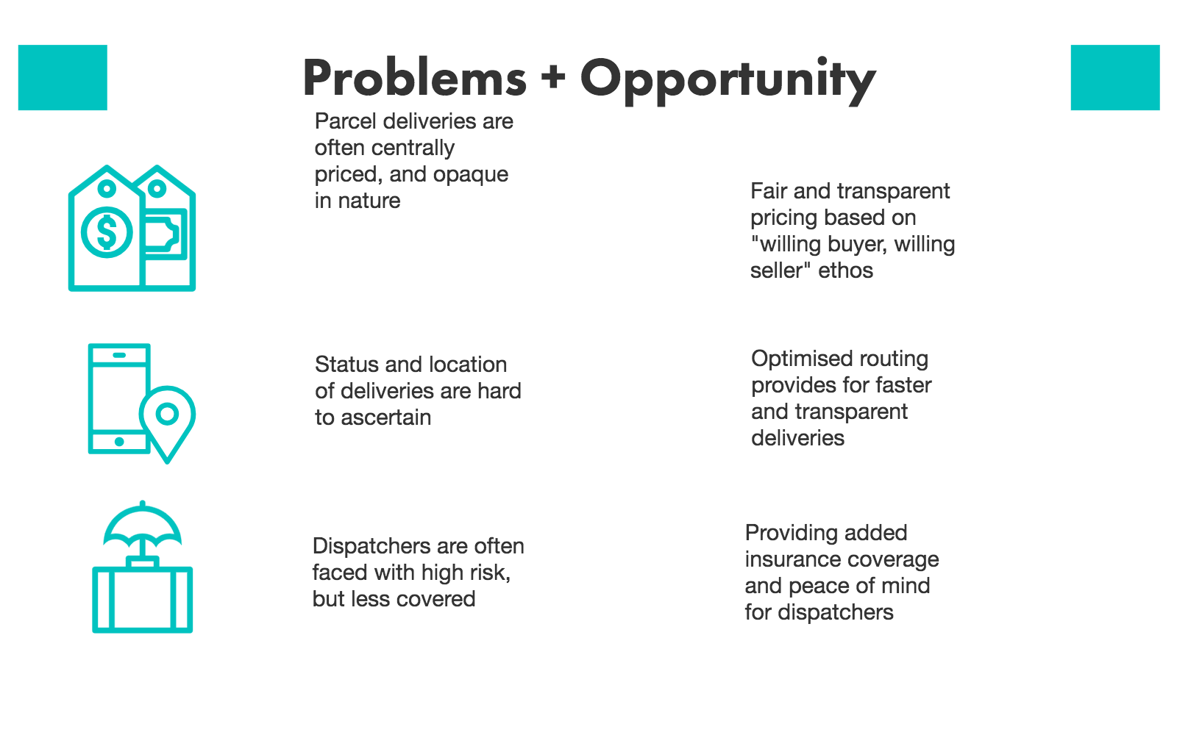
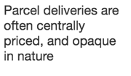

Slide 4


Slide 5
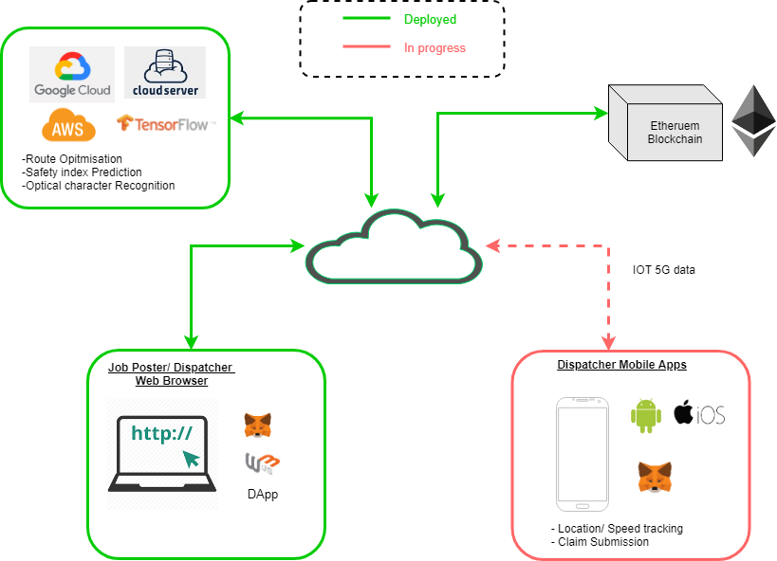
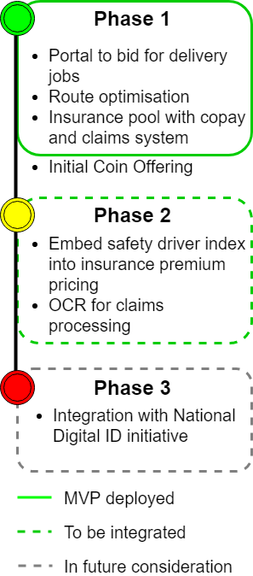

Slide 6
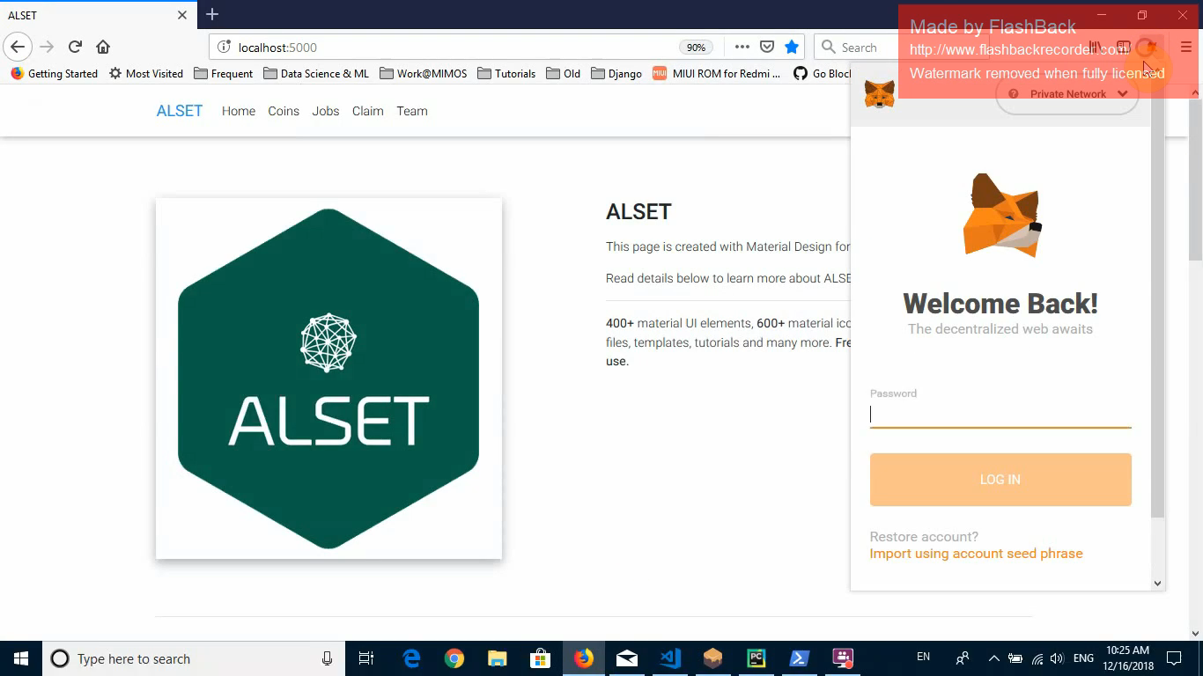
Demo on posting/picking up a job

Slide 7
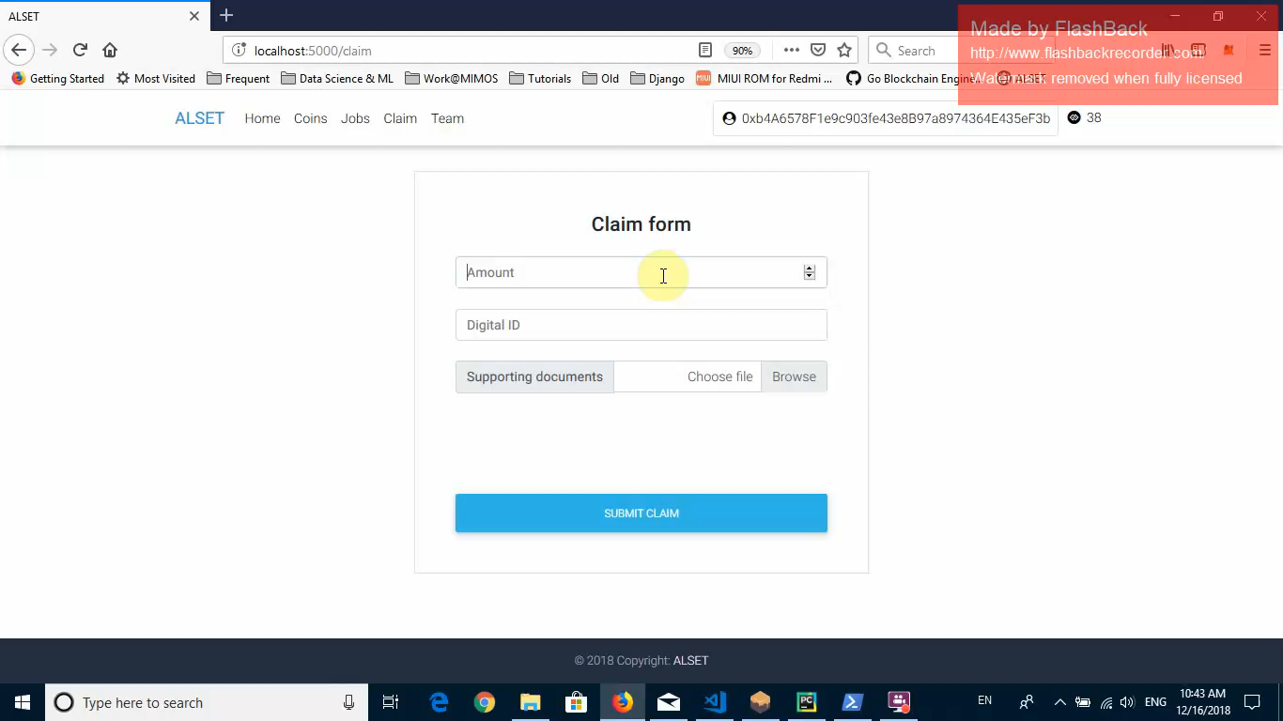
Demo on insurance claims

Slide 8
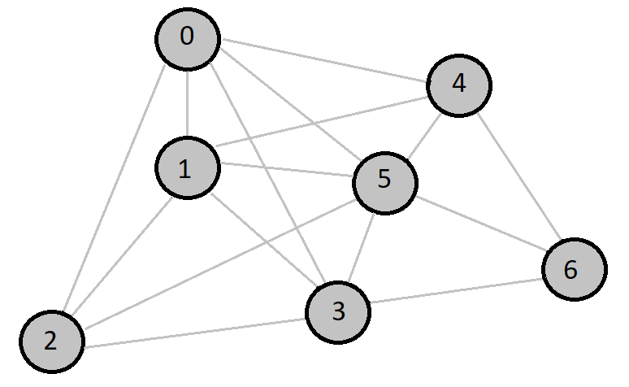
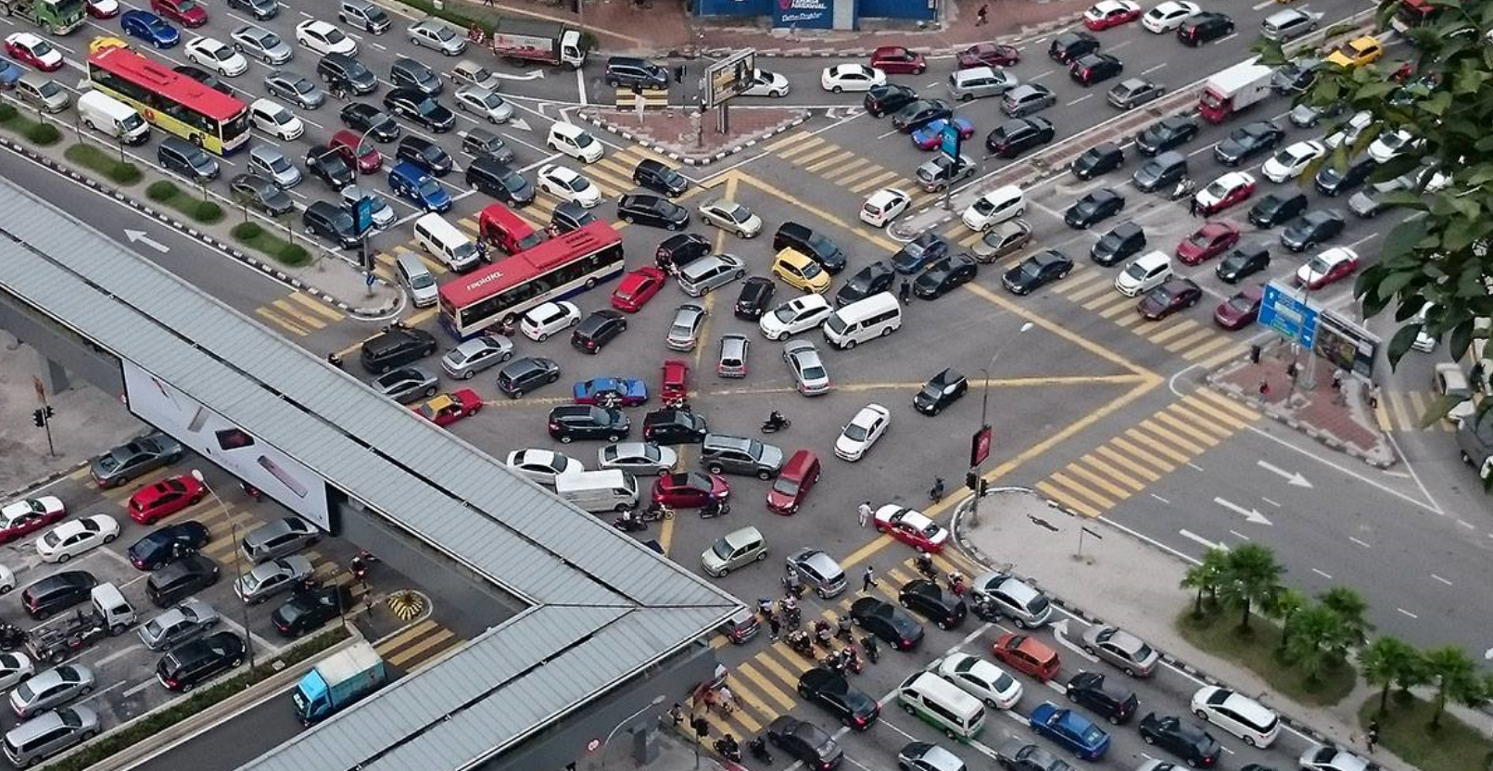
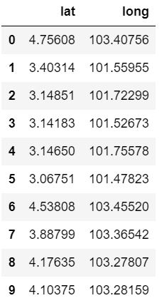
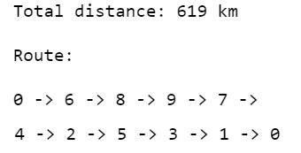
Routing optimisation
158 hours per person stuck in traffic annually
~RM3.6K per person in annual salary
By knowing the path, we can recommend Points of Interest to users.

Slide 9
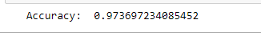
Safe Dispatcher Index using LSTM
IOT data (sudden break, speed, sudden stop etc.) collected from apps installed at dispatcher’s phone
Time-series-forecasting using LSTM
We use t-n,…, t-2,t-1 datapoints as inputs
If dispatcher has a ‘good’ driver behaviour, more claims amount can be disbursed when driver involved in accident
Results:

Slide 10
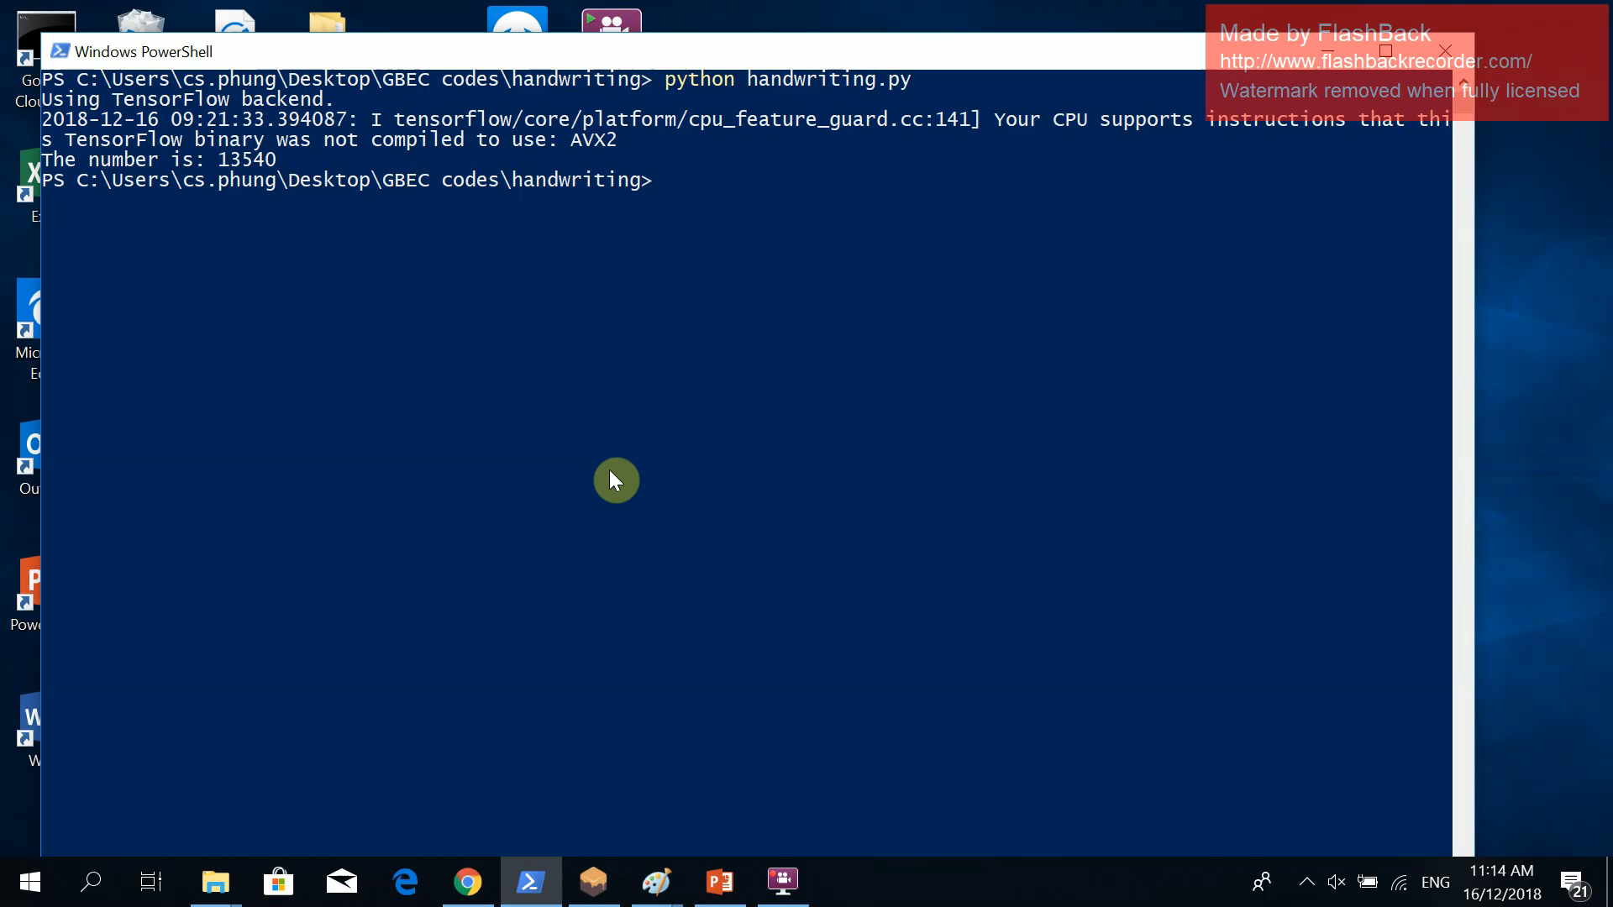
Optical Character Recognition (OCR)

Slide 11
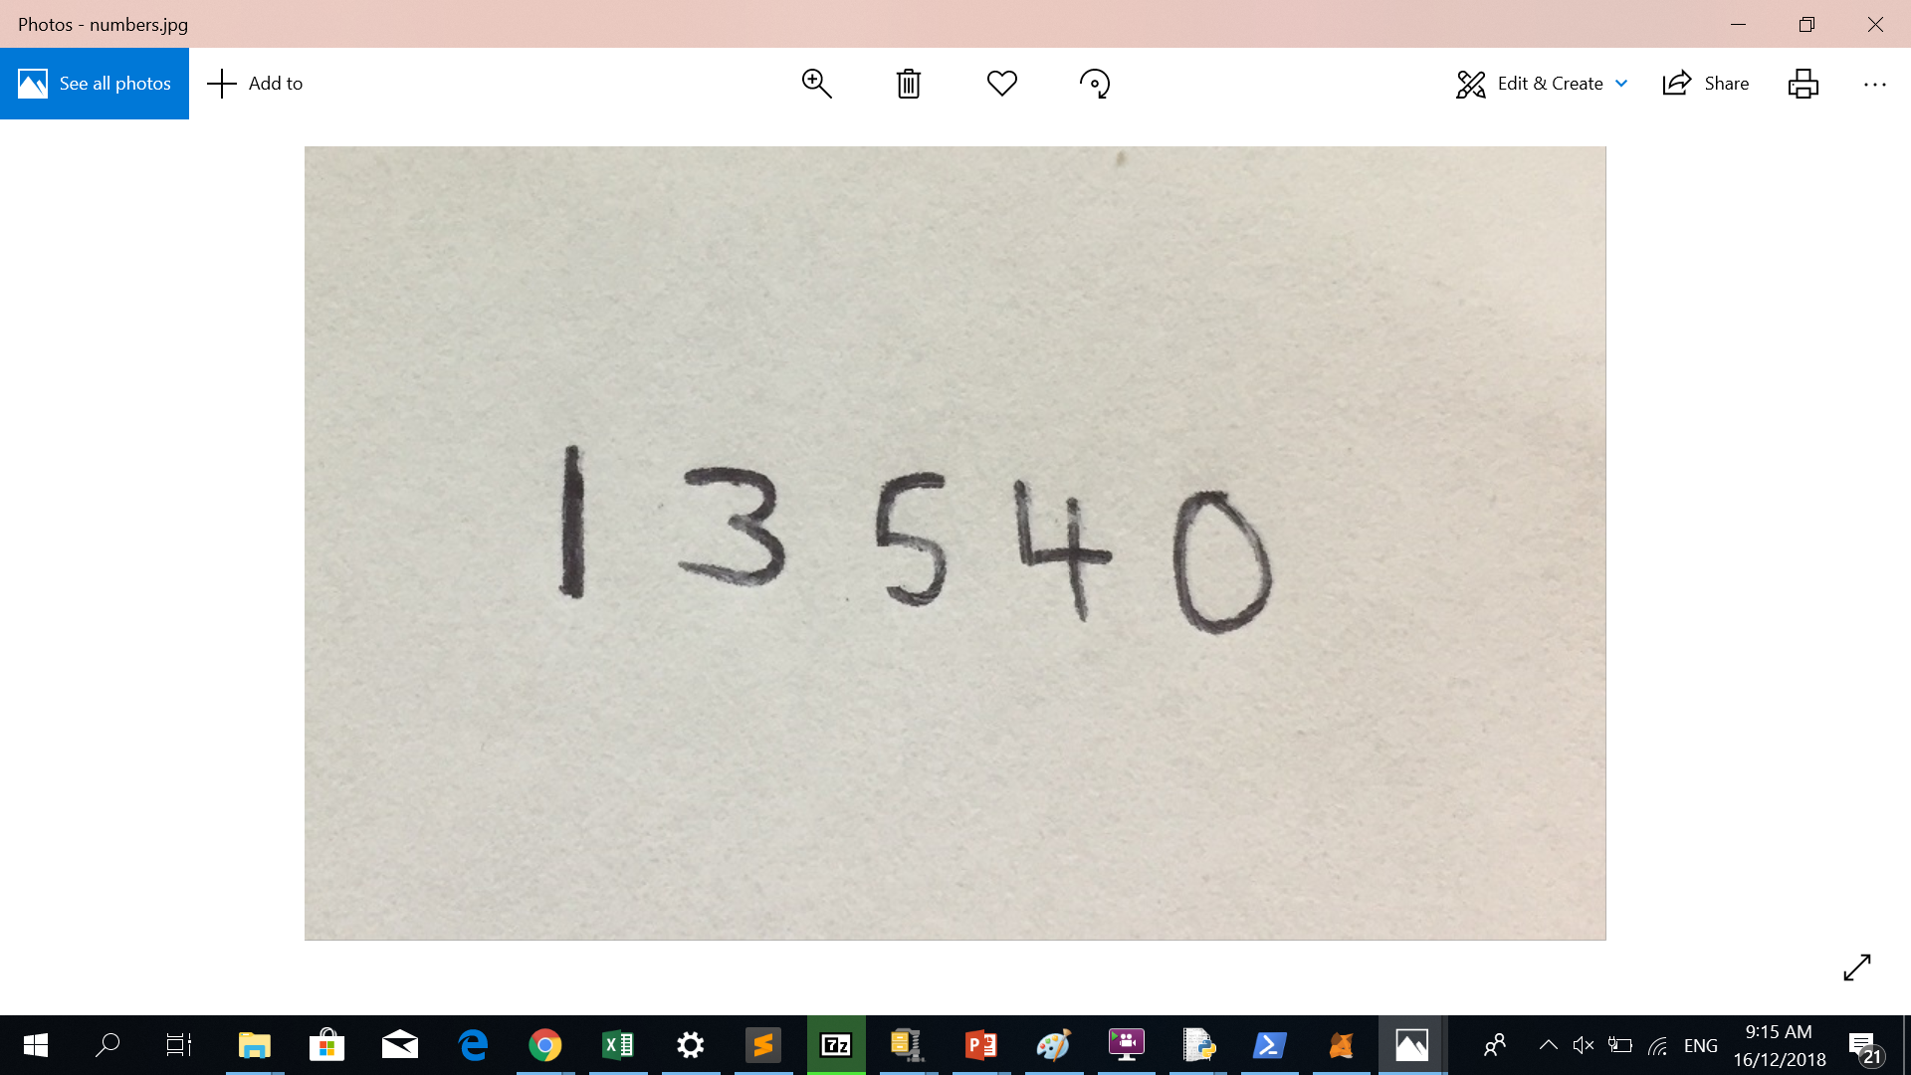
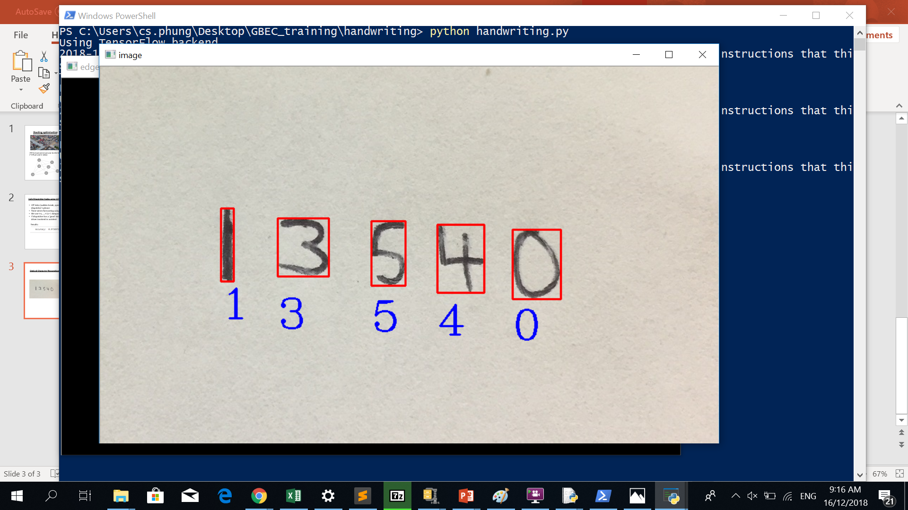
Optical Character Recognition (OCR)

